Slide 1

Intern Project
Tailoring Workspace to Next Generation

Slide 2
agenda
What was the Intern Project about?
What were the questions asked?
What methods were used to gather required information?
Present findings from the research and survey conducted
Present a layout of a floor plan based on the data collected from survey and focus group

Slide 3
What was our question?
How do you tailor the workspace to the next generation?
Related-Questions
What are some generational differences in the workplace?
What are the perspectives of different departments?
Are open-space concepts effective for the workplace? Should we move towards them?
What are some physical amenities, accommodations, and benefits that employees would like to see?

Slide 4

ELEMENTS
WORKSPACE
LOCATION
PRODUCTIVE
WORKSPACE
AMENITIES
FURNITURE AND
EQUIPMENT
HEALTH AND
WELLNESS

Slide 5
Research Implementation
The research was broken up into two processes: Survey and Focus Groups.
Online survey was conducted to collect data focusing on the younger generation from the ages of 18-35.
20 Focus groups were setup based on the departments here at the bank to collect information about current status of workspace and employees’ preferences for productive workspace.

Slide 6
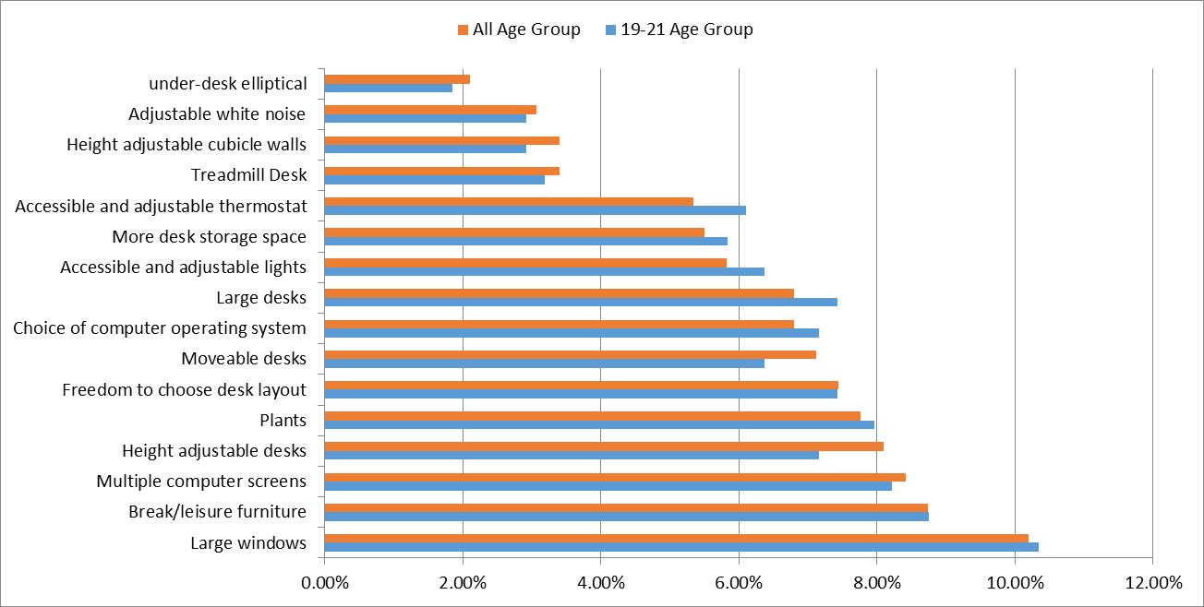
What are some generational differences in the workplace?
Based on the data collected from survey and focus groups, the generational differences are minimal.
Only a few facilities are more popular in the age group above 21 years than in the age group of 18-21 for all of the 5 elements.
The chart represents Furniture and Equipment preferences categorized by age group.

Slide 7
Element 1 Workspace
Focus Groups:
Collaboration Areas for creative workspace
Better/More seating areas
Survey:
70.37% of people prefer Modern(combination or open) workspaces
More interactive activities
33.3% of people value privacy in their workspace while another 33.3% value collaboration (other 33.3% say it depends of department)

Slide 8
Graphs and charts: Workspace

Slide 9
Element 2 furniture And Equipment
Focus Groups:
Adjustable Desks
Ergonomic chairs
Newer software/touchscreen Kanban board
Survey:
Large Windows (76.8%)
Multiple computer screens (62.9%)
Adjustable/Moveable Desks (61%)
Break/Leisure Furniture (65.9%)
Plants (58.5%)

Slide 10
Graphs and charts

Slide 11
Element 3 amenities
Focus Groups:
Cafeteria
Bigger Dining Area/Oasis Room
Subsidized Food/Events
Game Room
Survey:
Cafeteria (58.5%)
Health conscious food choices (53.7%)
Nearby restaurants (62.2%)
Onsite coffee shop (56.1%)

Slide 12
Graphs and charts: Amenities

Slide 13
Element 4 Health & wellness
Focus Groups:
Reimbursement Policy: More flexibility
On-site Fitness Center
Locker rooms/showers
Survey:
On-site Fitness Center (56.1%)
Local Fitness Center Vouchers (52.4%)

Slide 14
Graphs: Health And Wellness

Slide 15
Element 5 location
Focus Groups:
Downtown
West Des Moines (w/amenities)
Survey:
63.8% of the people currently work in downtown
69.9% drive to work daily
14.5% would prefer to work from home all the time

Slide 16
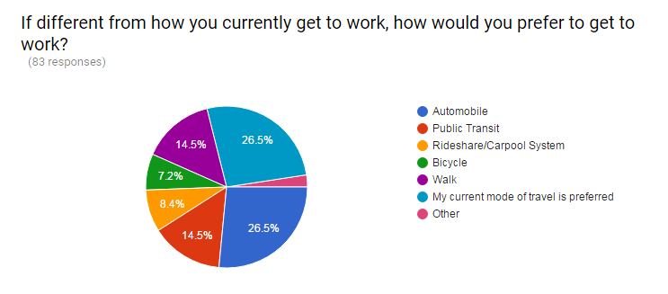
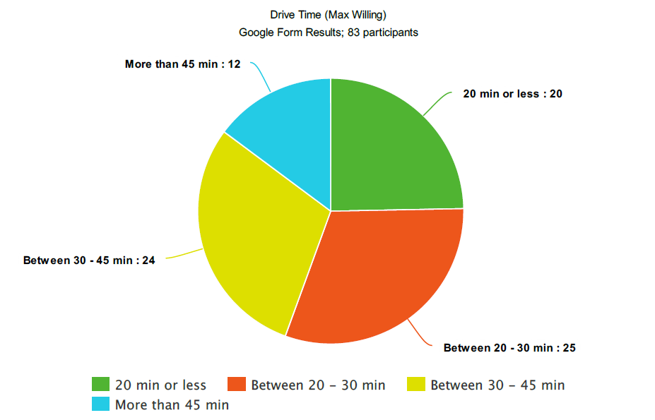
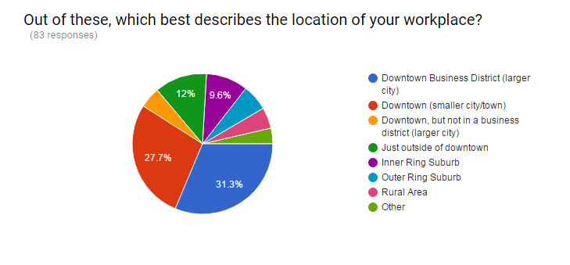
Graphs and charts: Location

Slide 17

Any questions?

